Slide 1
Introduction to accelerated computing using GPUs
April 12, 2021
SCITAS

Slide 2
April 12
Presentation of the course (10min)
N. Varini
Introduction to GPUs (30min)
E. Lanti
Introduction to CUDA Fortran(2h30m)
N. Varini
April 19
Recapitulation (10min)
N. Varini
CUDA intermediate (30 min)
N.Varini
C for Fortran developers (20min)
N. Richart
Hands-on (2h)

Slide 3
Goal of the course
To understand the opportunity that comes with GPUs and accelerated computing
To present the GPU architectures and the differences with CPUs
To start programming with GPUs (CUDA)
To port your code (or part of it) on GPU
To read and understand existing GPU code

Slide 4
Introduction to GPUs
A brief history of CPU evolution
GPUs in the Top500
CPU vs GPU
  Example of a Marconi100 node
Programming environments for GPUs
  CUDA
  ROCm
  OpenMP
  OpenACC

Slide 5
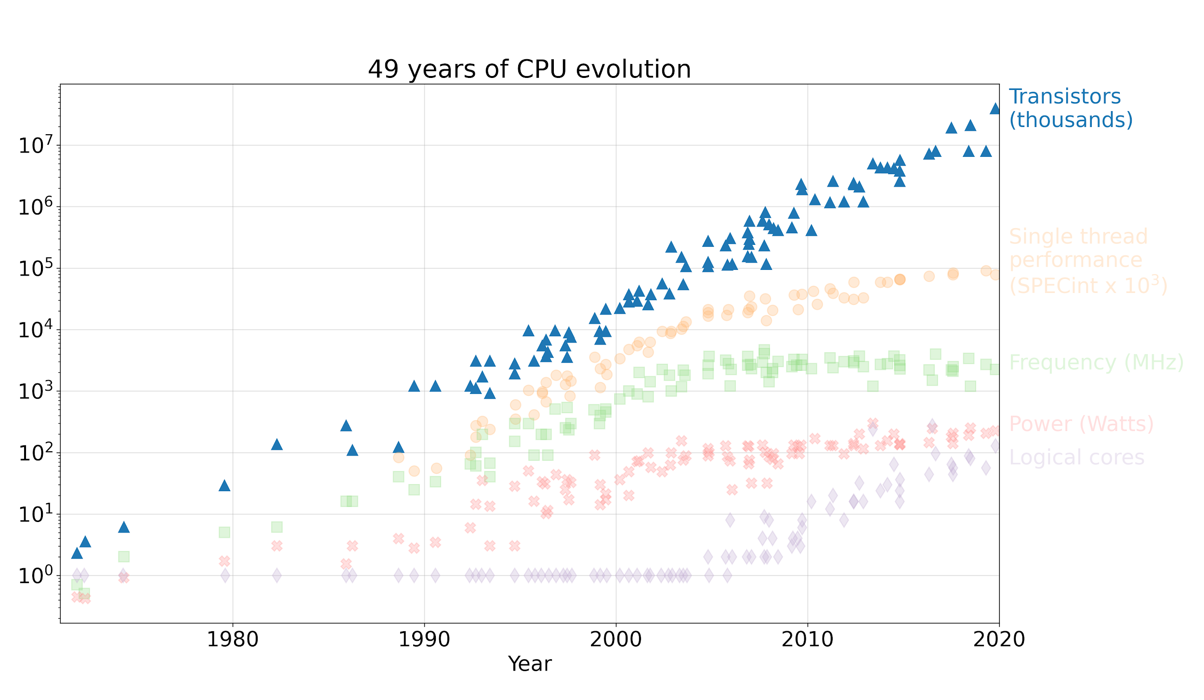
A brief history of CPU evolution
Moore’s law (1965): the number of transistors doubles every two years

Slide 6
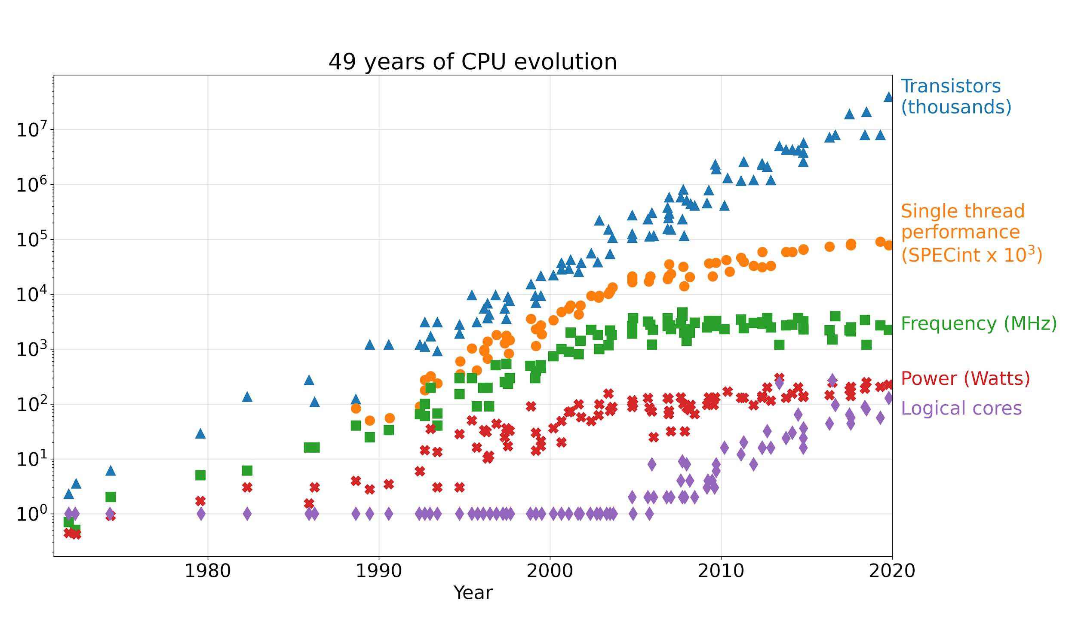
A brief history of CPU evolution
Moore’s law: the number of transistors doubles every two years
Before 2005^{ish} single core CPUs. New CPU = faster code
Since then, because of power wall multicore and many-thread

Slide 7
A brief history of CPU evolution
Vectorization
Moore’s law: the number of transistors doubles every two years
Before 2005^{ish} single core CPUs. New CPU = faster code
Since then, because of power wall multicore and many-thread
Free
Parallelization
Notes:
Simplified view. We don’t talk about memory bandwidth, etc
Frequency increase is the “free lunch”
For vectorization and parallelism, you have to work a bit

Slide 8
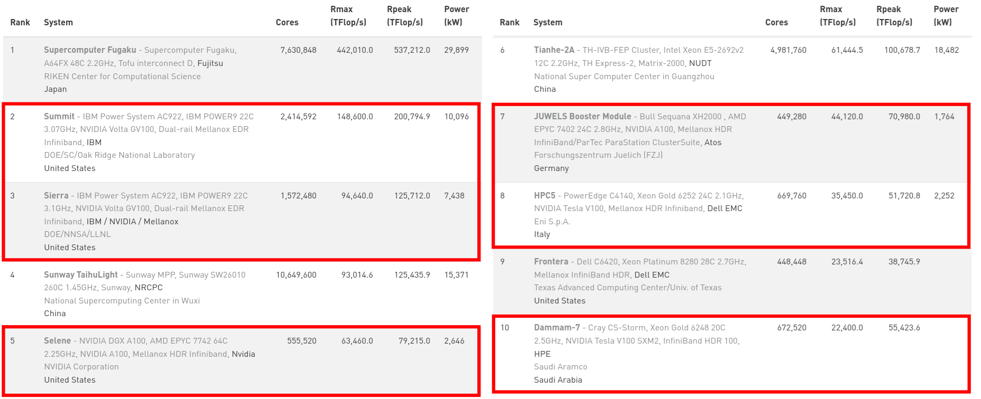
GPU-equipped HPC systems in the Top500
As of November 2020:
60% of the top 10 computers have GPU accelerators
~30% of the 500 machines with GPUs (140 NVIDIA, 1 AMD)
Rapid increase in GPU usage around 2015 (51/500 in 2014)
Until now, market has been dominated by NVIDIA
Other vendors in the future (El Capitan and Frontier will have AMD GPUs)

Slide 9
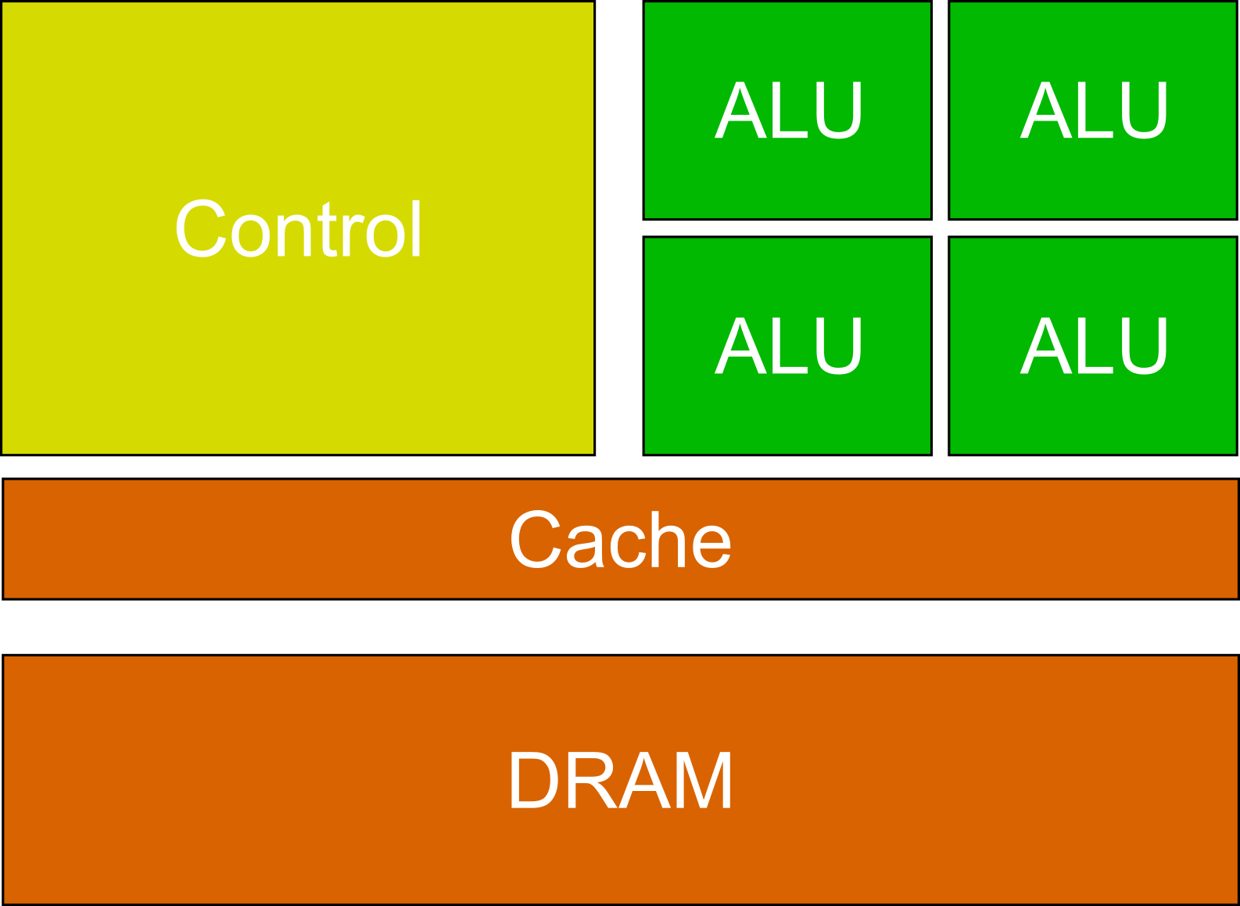
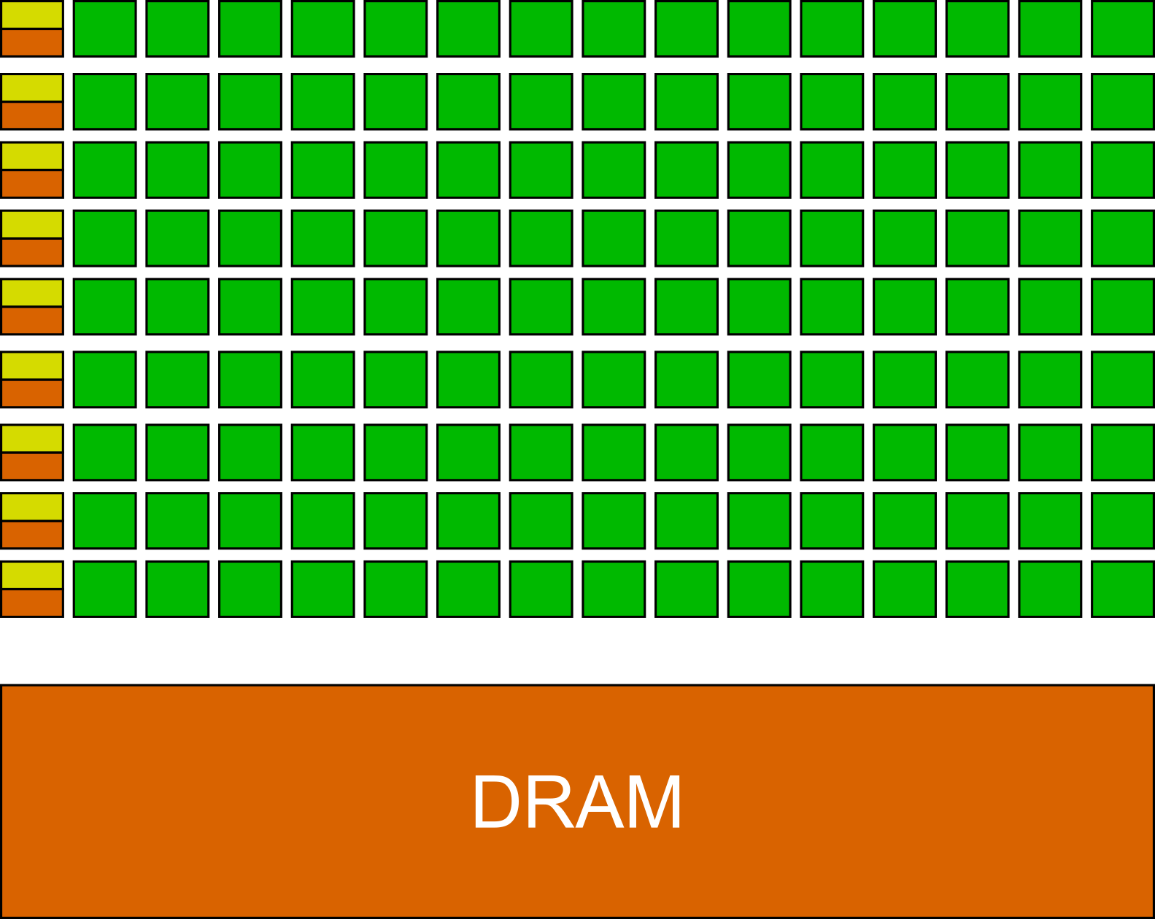
CPU vs GPU
Different designs for different goals
CPU
  Latency oriented design
  Powerful ALUs
  Sophisticated control logic
  Large cache memories
  Really good for sequential code performance
GPU
  Throughput oriented design
  Small caches
  Simple control
  Many long latency but heavily pipelined ALUs
  Requires massive number of threads
  to hide latency

Slide 10
CPU vs GPU
What can be expected
Intel Xeon-Gold, 2.1GHz, 20 cores + 192GB DDR4 RAM
  Memory bandwidth: 130GB/s
  Peak performance: 1.34 TFLOPS (DP)
NVIDIA V100, PCIe, 32GB
  Memory bandwidth: 900GB/s
  Peak performance: 7 TFLOPS (DP)
As an estimate GPUs:
Perform ~10x more FLOPS than a CPU (~200x for 1 core)
Have ~10x better memory bandwidth than CPUs

Slide 11
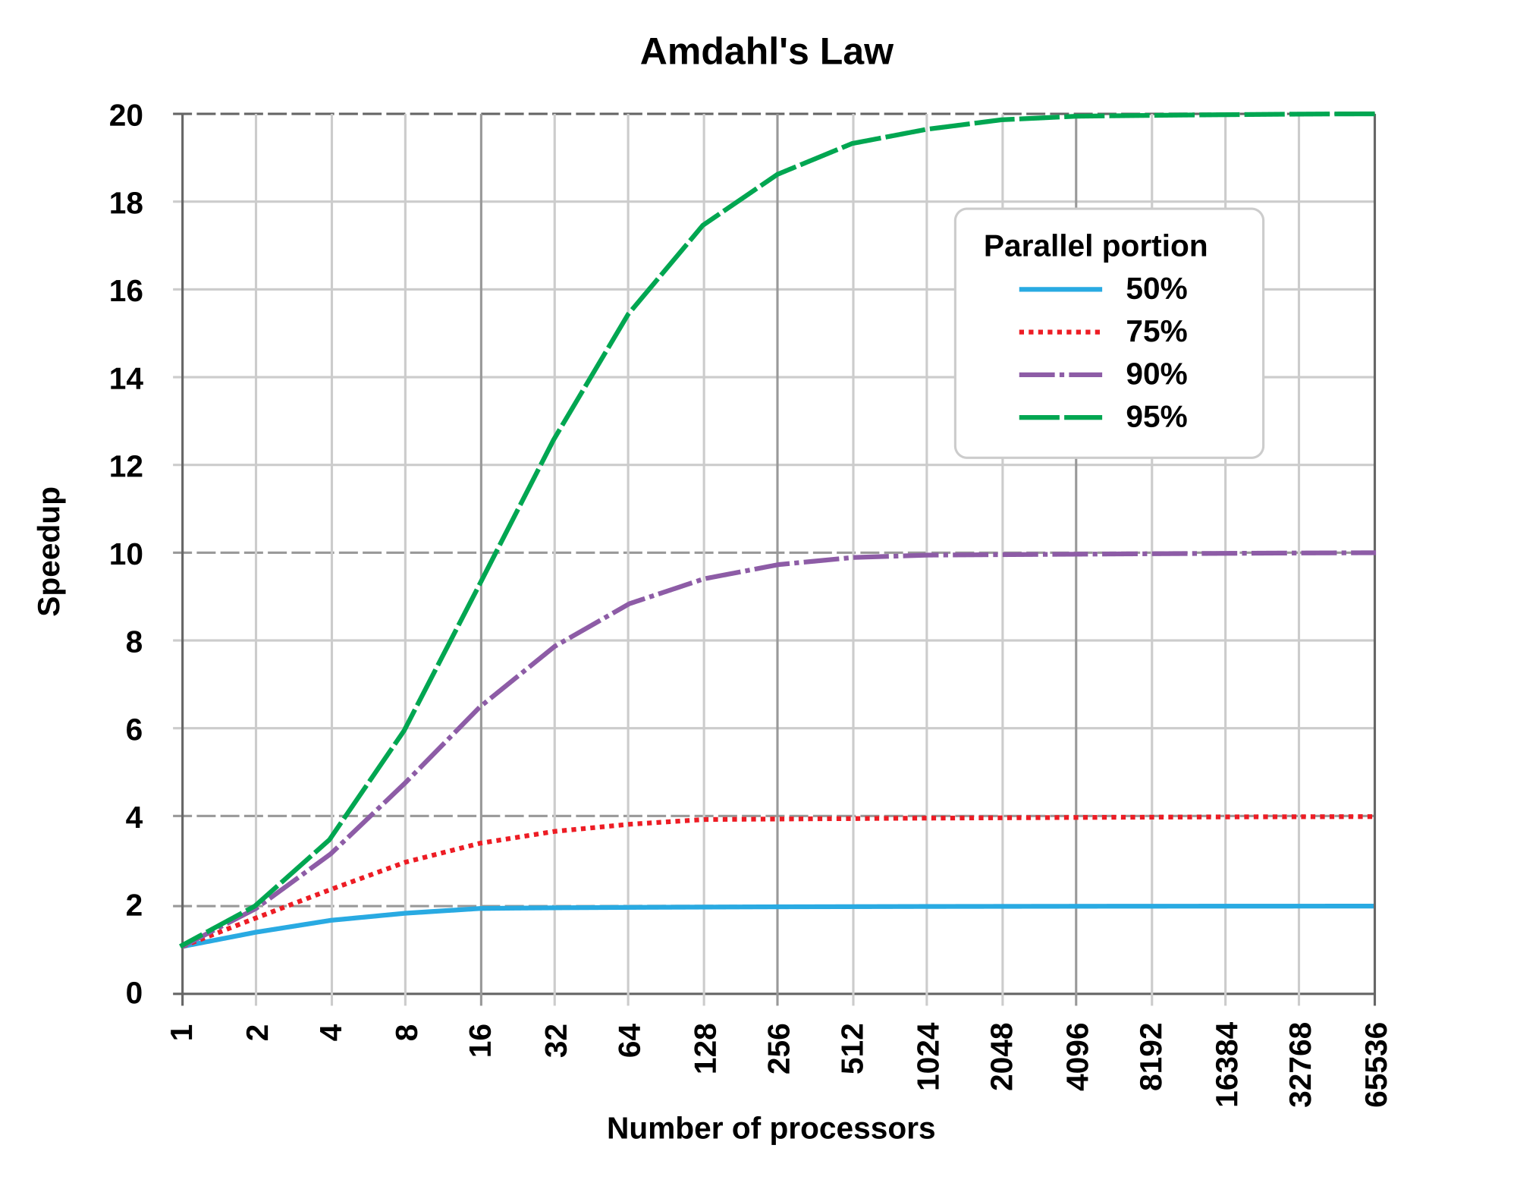
Winning applications use both CPU and GPU
Remember that:
CPUs are better than GPUs for sequential work
GPUs are better than CPUs for heavily parallel work
CPUs and GPUs are not mutually exclusive!
You must identify the parts of your code that would benefit to be ported on GPUs
Side notes
Before jumping into coding, estimate the achievable gains!
Pareto rule: usually, 80% of the speedup comes from
20% of the code
Amdahl’s law gives the theoretical speedup as a function
of the parallel portion of the code
Wikipedia

Slide 12
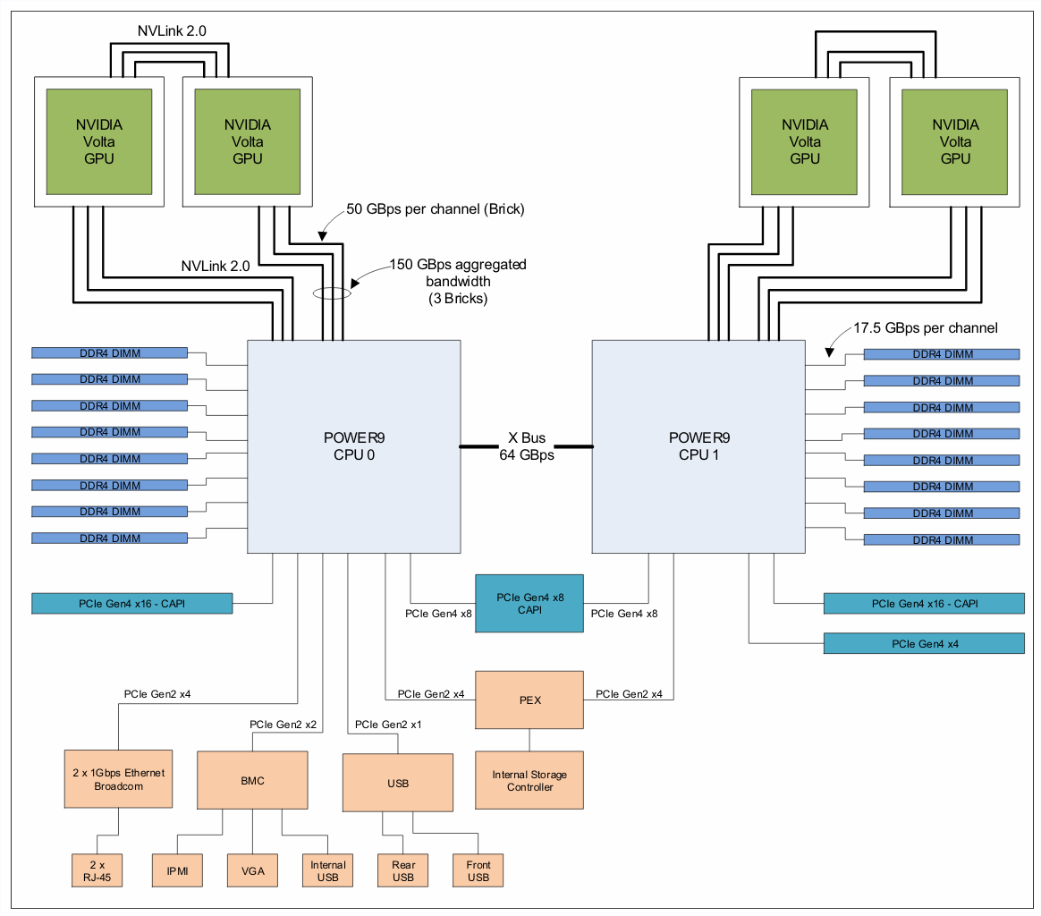
Marconi100 node architecture
Two symmetric designs
Two CPUs / node
0.8 TFLOPS / CPU
4 NVIDIA V100 cards / node
7.8 TFLOPS / card
Memory transfers
  CPU - CPU (64 GB/s)
  CPU - RAM (140 GB/s)
  CPU - GPU (150 GB/s)
  GPU - GPU (150 GB/s)

Slide 13
Marconi100 node architecture
Two symmetric designs
Two CPUs / node
0.8 TFLOPS / CPU
4 NVIDIA V100 cards / node
7.8 TFLOPS / card
Memory transfers
  CPU - CPU (64 GB/s)
  CPU - RAM (140 GB/s)
  CPU - GPU (150 GB/s)
  GPU - GPU (150 GB/s)

Slide 14
Marconi100 node architecture
Two symmetric designs
Two CPUs / node
0.8 TFLOPS / CPU
4 NVIDIA V100 cards / node
7.8 TFLOPS / card
Memory transfers
  CPU - CPU (64 GB/s)
  CPU - RAM (140 GB/s)
  CPU - GPU (150 GB/s)
  GPU - GPU (150 GB/s)

Slide 15
Marconi100 node architecture
Two symmetric designs
Two CPUs / node
0.8 TFLOPS / CPU
4 NVIDIA V100 cards / node
7.8 TFLOPS / card
Memory transfers
  CPU - CPU (64 GB/s)
  CPU - RAM (140 GB/s)
  CPU - GPU (150 GB/s)
  GPU - GPU (150 GB/s)

Slide 16
Marconi100 node architecture
Two symmetric designs
Two CPUs / node
0.8 TFLOPS / CPU
4 NVIDIA V100 cards / node
7.8 TFLOPS / card
Memory transfers
  CPU - CPU (64 GB/s)
  CPU - RAM (140 GB/s)
  CPU - GPU (150 GB/s)
  GPU - GPU (150 GB/s)

Slide 17
Marconi100 node architecture
Two symmetric designs
Two CPUs / node
0.8 TFLOPS / CPU
4 NVIDIA V100 cards / node
7.8 TFLOPS / card
Memory transfers
  CPU - CPU (64 GB/s)
  CPU - RAM (140 GB/s)
  CPU - GPU (150 GB/s)
  GPU - GPU (150 GB/s)

Slide 18
Marconi100 node architecture
Two symmetric designs
Two CPUs / node
0.8 TFLOPS / CPU
4 NVIDIA V100 cards / node
7.8 TFLOPS / card
Memory transfers
  CPU - CPU (64 GB/s)
  CPU - RAM (140 GB/s)
  CPU - GPU (150 GB/s)
  GPU - GPU (150 GB/s)
Know your hardware, know your limitations!

Slide 19
Programming the GPU
CUDA
Developed and owned by NVIDIA
  Freely available
  Mature language (in development since 2007)
Extensions to programming languages
  C, C++, Fortran (only IBM and nvidia compilers), PyCUDA
  Simple syntax
Very rich ecosystem
  Many libraries
    cuBLAS, cuSPARSE, cuFFT, etc.
  Development tools
    Nsight, CUDA-GDB, CUDA MEMCHECK
Pros
Performance
Cons
Portability (NVIDIA)
Availability (Fortran)

Slide 20
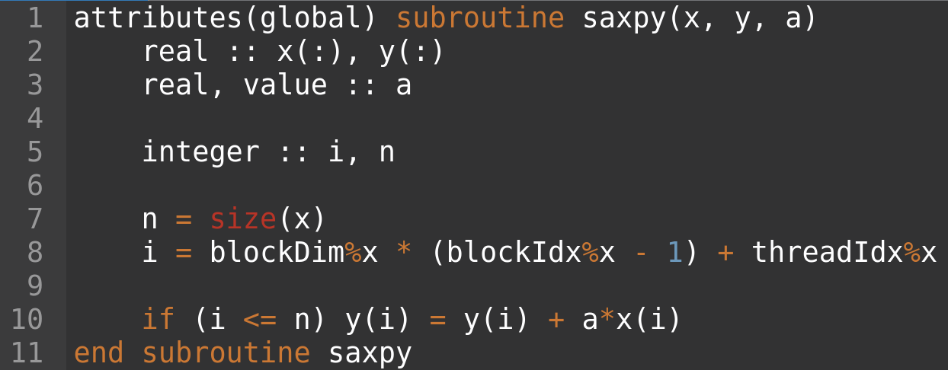
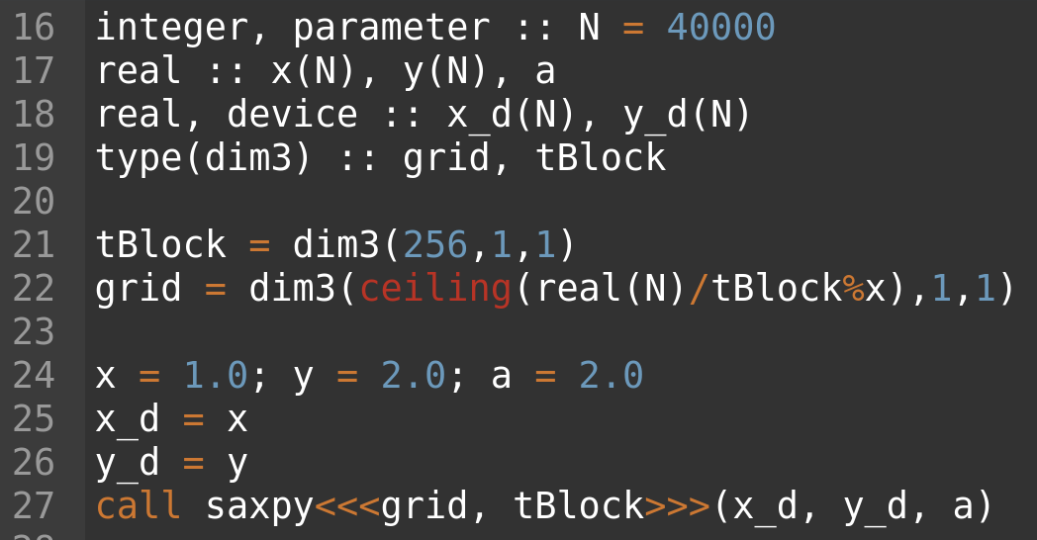
Programming the GPU
CUDA (example y = ax + y)
Define kernel subroutine
Compute vector index from the current thread
Compute saxpy (with boundary check)
Define execution configuration
Launch kernel

Slide 21
Programming the GPU
ROCm (HIP)
ROCm
  Open-source software development platform
  Supported by AMD
  ROCm 1.0 released in 2016 (now ROCm 4.0)
Bundles of tools and libraries
  Profiler, debugger, etc.
  Math libraries (hipBLAS, rocFFT, hipSPARSE, etc.)
HIP
  Runtime API and Kernel language
  C++ (HIPFort for Fortran interface)
  Syntax close to CUDA
  Portable (support both AMD and NVIDIA)
Pros
Portability
Performance
Cons
Maturity

Slide 22
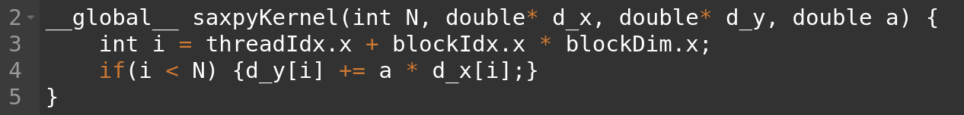
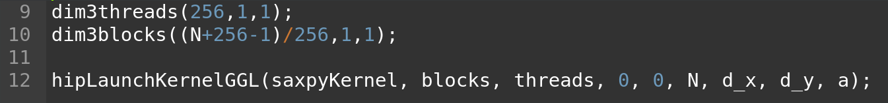
Programming the GPU
ROCm (example y = ax + y)
Syntax very similar to CUDA
Launch the kernel (<<<blocks, threads>>> in CUDA)

Slide 23
Programming the GPU
OpenMP
OpenMP
  Standardized
  Available for C, C++, and Fortran
  Directive based multithreading library
  Very good support (GNU, ARM, Intel, IBM, PGI, etc)
OpenMP 4.5
  Introduction for offloading support
OpenMP 5.1
  Current version
  Better support for accelerators
Pros
Standard
Portability
Ease of use
Cons
Performance

Slide 24
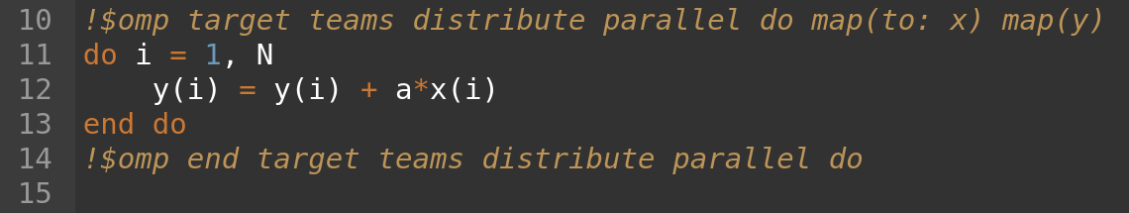
Programming the GPU
OpenMP (example y = ax + y)
Transfer data to and from GPU
Specify to parallelize the do loop
Distribute work among threads
Create teams of threads
Define kernel region to offload
Define OpenMP region

Slide 25
Programming the GPU
OpenACC
OpenACC
  Standardized
  Co-developed by NVIDIA
  Designed for heterogeneous computing
  Available for C, C++, and Fortran
  Directive based
OpenACC merge with OpenMP?
OpenMP merge with OpenACC?
Pros
Portability
Performance
Ease of use
Cons
Availability (Fortran)
Non NVIDIA GPUs

Slide 26
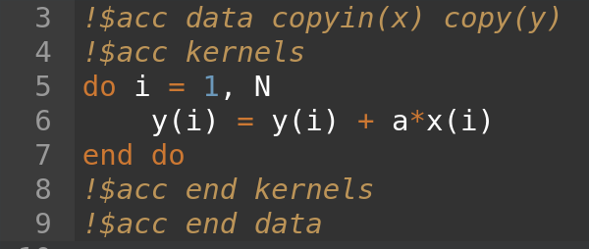
Programming the GPU
OpenACC (example y = ax + y)
Memory management
Create kernel out of enclosed
lines
OpenACC pragmas

Slide 27

Accelerating Applications with CUDA Fortran
A practical approach
April 12, 2021
SCITAS

Slide 28
Let’s start !
Connect to the cluster
In a terminal
  Connect to the cluster with:
  $> ssh <GASPAR>@izar.epfl.ch
  Create a working directory:
  $> mkdir cuda_fortran_workshop
  Step into the directory:
  $> cd cuda_fortran_workshop
  Load the compiler with:
  $> module load nvhpc
  Git clone the exercise:
  $> git clone https://c4science.ch/source/introCUDA.git

Slide 29
Warm up
In a terminal
  Change directory to introCUDA/examples/warmup
$sbatch script.sh
script.sh
1 #!/bin/bash -l
2 #SBATCH --nodes=1
3 #SBATCH --ntasks-per-node=1
4 #SBATCH --ntasks-per-core=1
5 #SBATCH --cpus-per-task=1
6 #SBATCH --gres=gpu:1
7 #SBATCH --reservation=spc-cuda-training-12.04
8 #SBATCH --account=spc-cuda-training
9 #SBATCH --time=0:05:00
10
11 module load nvhpc
12
13 nvidia-smi -a > output
nvidia-smi is printing information about the GPU.
We are going to use one core and one GPU.

Slide 30
Where to find information
Websites
NVIDIA HPC SDK programming guide for Fortran
https://docs.nvidia.com/hpc-sdk/compilers/cuda-fortran-prog-guide/
NVIDIA HPC SDK programming guide for C
https://docs.nvidia.com/cuda/cuda-c-programming-guide/index.html
Books
Professional CUDA C programming, J. Cheng, M. Grossman, T. McKercher
CUDA Fortran for scientists and engineers, M. Fatica, G. Ruetsch
Programming massively parallel processors, D. Kirk, W. Hwu

Slide 31
Topics
GPU-accelerated vs. CPU-only Applications
CUDA Kernel Execution
Parallel Memory Access
Appendix: Glossary

Slide 32
GPU-accelerated vs
CPU-only applications

Slide 33
In CPU-only applications data is allocated on CPU
TIME
DATA
CPU
initialize()
Time

Slide 34
…and all work is performed on CPU
TIME
DATA
CPU
initialize()
performWork()
Time

Slide 35
…and all work is performed on CPU
TIME
DATA
CPU
initialize()
performWork()
verifyWork()
Time

Slide 36
Let’s start simple
Hello world
module helloWorld
implicit none
contains
subroutine hello_world_cpu
write(*,*) 'hello world'
end subroutine hello_world_cpu
end module helloWorld
program testHelloWorld
use helloWorld
call hello_world_cpu
end program testHelloWorld

Slide 37
In accelerated applications data is allocated with managed attribute
TIME
DATA
GPU
CPU
GPU
CPU
Time

Slide 38
… where it can be accessed and worked on by the CPU
TIME
DATA
GPU
CPU
GPU
CPU
initialize()
Time

Slide 39
… and automatically migrated to the GPU where parallel work can be done
TIME
DATA
GPU
CPU
GPU
performWork()
CPU
initialize()
Time

Slide 40
Work on the GPU is asynchronous, and CPU can work at the same time
TIME
DATA
GPU
CPU
GPU
performWork()
CPU
initialize()
cpuWork()
Time

Slide 41
CPU code can sync with the asynchronous GPU work, waiting for it to complete, with cudaDeviceSynchronize()
TIME
DATA
GPU
CPU
GPU
performWork()
CPU
initialize()
cpuWork()
synchronize
Time

Slide 42
… data accesses by the CPU will automatically be migrated
TIME
DATA
GPU
CPU
GPU
performWork()
CPU
initialize()
cpuWork()
verifyWork()
synchronize
Time

Slide 43
GPU programming
Building blocks
CUDA API
CudaMallocManaged()
Grid, blocks, threads
CudaDeviceSynchronize()
GPU Function
Memory allocation
Kernel execution
Synchronization
We are going to introduce those concepts with a couple of trivial examples

Slide 44
First GPU code - Hello World
Kernels and Synchronization
module helloWorld
implicit none
contains
attributes(global) subroutine hello_world_cuda
write(*,*) 'hello world from CUDA code'
end subroutine hello_world_cuda
attributes(global) subroutine hello_world_cuda_threads
integer :: i
i = threadIdx%x
write(*,*) 'hello world from thread', i
end subroutine hello_world_cuda_threads
end module helloWorld
program testHelloWorld
use helloWorld
use cudafor
implicit none
integer :: istat
call hello_world_cuda<<<1, 1>>>
istat = cudaDeviceSynchronize()
call hello_world_cuda_threads<<<1, 8>>>
istat = cudaDeviceSynchronize()
end program testHelloWorld
attributes(global) tells to the compiler that the subroutine will be executed on the GPU
threadIdx%x is the (1D) thread local index
<<<#Blocks, #threads>>> is called kernel “execution configuration” and specifies the number of blocks and threads to be used for a specific function
CudaDeviceSynchronize() waits for the computation on the device to be finished
By default kernel calls from the CPU are asynchronous

Slide 45
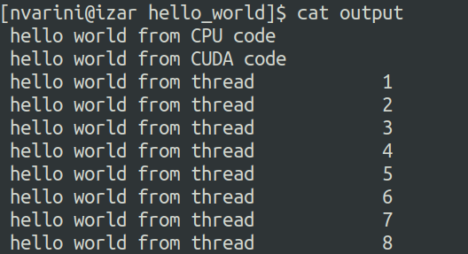
Hello World output
Each thread executes the kernel

Slide 46
Memory managment
program testMemory
use memoryTest
use cudafor
implicit none
integer :: istat, i, j, N
real, managed, allocatable :: a(:)
N=8
allocate(a(N))
do i = 1, N
a(i) = real(i) * 0.124
end do
write(*,*) 'Before GPU modification'
call print_cpu(a)
call modify_from_gpu<<<1, 1>>>(a)
istat = cudaDeviceSynchronize()
write(*,*) 'After GPU modification'
call print_cpu(a)
deallocate(A)
end program testMemory
module memoryTest
implicit none
contains
subroutine print_cpu(a)
real :: a(:)
write(*,*) a
end subroutine print_cpu
attributes(global) subroutine modify_from_gpu(a)
real :: a(:)
a = a + 10.0
end subroutine modify_from_gpu
end module memoryTest
The managed attribute allocates an array through the managed memory mechanism
The data is first printed from the CPU
Modified by the GPU
And printed again from CPU
The memory a(:) is accessible from host and device

Slide 47
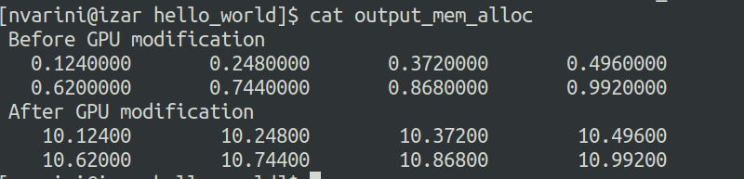
Output memory management

Slide 48
CUDA kernel execution

Slide 49
DATA
GPU
CPU
GPU
performWork()
CPU
initialize()
cpuWork()
verifyWork()
synchronize
Time

Slide 50
Kernel execution
performWork<<<2, 4>>>()
GPU
GPUs do work in parallel

Slide 51
Kernel execution
performWork<<<2, 4>>>()
GPU
GPU work is done in a thread

Slide 52
Kernel execution
performWork<<<2, 4>>>()
GPU
Many threads run in parallel

Slide 53
Kernel execution
performWork<<<2, 4>>>()
GPU
A collection of threads is a block

Slide 54
Kernel execution
performWork<<<2, 4>>>()
GPU
There are many blocks

Slide 55
Kernel execution
performWork<<<2, 4>>>()
GPU
A collection of blocks is a grid

Slide 56
Kernel execution
performWork<<<2, 4>>>()
GPU
GPU functions are called kernels

Slide 57
Kernel execution
performWork<<<2, 4>>>()
GPU
Kernels are launched with an execution configuration

Slide 58
Kernel execution
performWork<<<2, 4>>>()
GPU
The execution configuration defines the number of blocks in the grid

Slide 59
Kernel execution
performWork<<<2, 4>>>()
GPU
… as well as the number of threads in each block

Slide 60
Kernel execution
performWork<<<2, 4>>>()
GPU
Every block in the grid contains the same number of threads

Slide 61
Exercise 1
Modify the helloworld example by changing the number of threads and leaving the number of blocks equal to 1. Try different thread configurations:
(16, 512, 1024). What happens?
Remove the cudaDeviceSynchronize() after the kernel call. What do you notice?

Slide 62
CUDA-provided thread hierarchy variables

Slide 63
Thread hierarchy
performWork<<<2, 4>>>()
GPU
Inside kernels definitions, CUDA-provided variables describe its executing thread, block, and grid

Slide 64
Thread hierarchy
performWork<<<2, 4>>>()
GPU
2
gridDim%x is the number of blocks in the grid, in this case 2

Slide 65
Thread hierarchy
performWork<<<2, 4>>>()
GPU
1
2
blockIdx%x is the index of the current block within the grid, in this case 1

Slide 66
Thread hierarchy
performWork<<<2, 4>>>()
GPU
1
2
blockIdx%x is the index of the current block within the grid, in this case 2

Slide 67
Thread hierarchy
performWork<<<2, 4>>>()
GPU
4
Inside a kernel blockDim%x describes the number of threads in a block. In this case 4

Slide 68
Thread hierarchy
performWork<<<2, 4>>>()
GPU
4
4
All blocks in a grid contain the same number of threads

Slide 69
Thread hierarchy
performWork<<<2, 4>>>()
GPU
1
2
3
4
1
2
3
4
Inside a kernel threadIdx%x describes the index of the thread within a block. In this case 1

Slide 70
Thread hierarchy
performWork<<<2, 4>>>()
GPU
1
2
3
4
1
2
3
4
Inside a kernel threadIdx%x describes the index of the thread within a block. In this case 2

Slide 71
Thread hierarchy
performWork<<<2, 4>>>()
GPU
1
2
3
4
1
2
3
4
Inside a kernel threadIdx%x describes the index of the thread within a block. In this case 3

Slide 72
Thread hierarchy
performWork<<<2, 4>>>()
GPU
1
2
3
4
1
2
3
4
Inside a kernel threadIdx%x describes the index of the thread within a block. In this case 4

Slide 73
Thread hierarchy
performWork<<<2, 4>>>()
GPU
1
2
3
4
1
2
3
4
Inside a kernel threadIdx%x describes the index of the thread within a block. In this case 1

Slide 74
Thread hierarchy
performWork<<<2, 4>>>()
GPU
1
2
3
4
1
2
3
4
Inside a kernel threadIdx%x describes the index of the thread within a block. In this case 2

Slide 75
Thread hierarchy
performWork<<<2, 4>>>()
GPU
1
2
3
4
1
2
3
4
Inside a kernel threadIdx%x describes the index of the thread within a block. In this case 3

Slide 76
Thread hierarchy
performWork<<<2, 4>>>()
GPU
1
2
3
4
1
2
3
4
Inside a kernel threadIdx%x describes the index of the thread within a block. In this case 4

Slide 77
Kernel execution
CUDA defines grids and blocks up to 3D, but you can use 1D, and 2D
In the host code, use the dim3 derived type and function to define the execution configuration:
type(dim3) :: nBlocks = dim3(16, 3, 1) ! 2D block grid
type(dim3) :: nThreads = dim3(16, 2, 4) ! 3D thread block
On the device, blocks and threads are described by built-in variables:
blockDim%{x, y, z} ! Number of blocks in the grid in the x, y, or z dimension
blockIdx%{x, y, z} ! x, y, or, z index of the block in the grid
threadDim%{x, y, z} ! Number of threads in a block in the x, y, or z dimension
threadIdx%{x, y, z} ! x, y, or, z index of the thread in the block

Slide 78
Exercise 2
Modify the helloworld example by changing the number of threads and the number of blocks.
Useful variables :
  block dimension: blockDim%x
  block index: blockIdx%x
  thread index: threadIdx%x
How can you combine those variables to obtain the global thread index?
Change the code to print the thread ID, block ID and global thread ID

Slide 79
Coordinating parallel threads

Slide 80
DATA
GPU
CPU
GPU
performWork()
CPU
initialize()
cpuWork()
synchronize
verifyWork()
Time

Slide 81
Assume data is in a 1D 1-indexed vector
1
5
GPU
2
6
DATA
3
7
4
8
performWork<<<2, 4>>>()
GPU

Slide 82
Somehow, each thread must be mapped to work on an element in the vector
1
5
GPU
2
6
DATA
3
7
4
8
performWork<<<2, 4>>>()
GPU

Slide 83
Recall that each thread has access to the size of its block via blockDim%x
1
5
2
6
GPU
DATA
3
7
4
8
performWork<<<2, 4>>>()
GPU
4
4

Slide 84
…and the index of its block within the grid via blockIdx%x
1
5
2
6
GPU
DATA
3
7
4
8
performWork<<<2, 4>>>()
1
2
GPU
4
4

Slide 85
…and its own index within its block via threadIdx%x
1
5
2
6
GPU
GP
DATA
3
7
4
8
performWork<<<2, 4>>>()
1
2
GPU
1
2
3
4
1
2
3
4
4
4

Slide 86
Using these variables, the formula threadIdx%x + (blockIdx%x-1) * blockDim%x will map each thread to one element in the vector
1
5
2
6
GPU
G
DATA
3
7
4
8
performWork<<<2, 4>>>()
1
2
GPU
1
2
3
4
1
2
3
4
4
4

Slide 87
threadIdx%x | + | blockIdx%x - 1 | * | blockDim%x
1 |  | 0 |  | 4
1
5
2
6
dataIndex
GPU
DATA
3
7
4
8
performWork<<<2, 4>>>()
1
2
GPU
1
2
3
4
1
2
3
4
4
4

Slide 88
threadIdx%x | + | blockIdx%x - 1 | * | blockDim%x
1 |  | 0 |  | 4
1
5
2
6
dataIndex
1
GPU
G
DATA
3
7
4
8
performWork<<<2, 4>>>()
1
2
GPU
1
2
3
4
1
2
3
4
4
4

Slide 89
threadIdx%x | + | blockIdx%x - 1 | * | blockDim%x
2 |  | 0 |  | 4
1
5
2
6
dataIndex
GPU
G
DATA
3
7
4
8
performWork<<<2, 4>>>()
1
2
GPU
1
2
3
4
1
2
3
4
4
4

Slide 90
threadIdx%x | + | blockIdx%x - 1 | * | blockDim%x
2 |  | 0 |  | 4
1
5
2
6
dataIndex
2
GPU
DATA
3
7
4
8
performWork<<<2, 4>>>()
1
2
GPU
1
2
3
4
1
2
3
4
4
4

Slide 91
threadIdx%x | + | blockIdx%x - 1 | * | blockDim%x
3 |  | 0 |  | 4
1
5
2
6
dataIndex
3
GPU
G
DATA
3
7
4
8
performWork<<<2, 4>>>()
1
2
GPU
1
2
3
4
1
2
3
4
4
4

Slide 92
threadIdx%x | + | blockIdx%x - 1 | * | blockDim%x
4 |  | 0 |  | 4
1
5
2
6
dataIndex
4
GPU
DATA
3
7
4
8
performWork<<<2, 4>>>()
1
2
GPU
1
2
3
4
1
2
3
4
4
4

Slide 93
threadIdx%x | + | blockIdx%x - 1 | * | blockDim%x
1 |  | 1 |  | 4
1
5
2
6
dataIndex
5
GPU
G
DATA
3
7
4
8
performWork<<<2, 4>>>()
1
2
GPU
1
2
3
4
1
2
3
4
4
4

Slide 94
threadIdx%x | + | blockIdx%x - 1 | * | blockDim%x
2 |  | 1 |  | 4
1
5
2
6
dataIndex
6
GPU
G
DATA
3
7
4
8
performWork<<<2, 4>>>()
1
2
GPU
1
2
3
4
1
2
3
4
4
4

Slide 95
threadIdx%x | + | blockIdx%x - 1 | * | blockDim%x
3 |  | 1 |  | 4
1
5
2
6
dataIndex
7
GPU
DATA
3
7
4
8
performWork<<<2, 4>>>()
1
2
GPU
1
2
3
4
1
2
3
4
4
4

Slide 96
threadIdx%x | + | blockIdx%x - 1 | * | blockDim%x
4 |  | 1 |  | 4
1
5
2
6
dataIndex
8
GPU
DATA
3
7
4
8
performWork<<<2, 4>>>()
1
2
GPU
1
2
3
4
1
2
3
4
4
4

Slide 97
Exercise 3 - Saxpy on GPU
module mathOps
implicit none
contains
attributes(global) subroutine saxpy_cuda(x, y, a)
real :: x(:), y(:)
real, value :: a
integer :: i, n
n = size(x)
! Implement saxpy on GPU here
end subroutine saxpy_cuda
subroutine saxpy_cpu(x, y, a)
real :: x(:), y(:)
real, value :: a
integer :: i, n
n = size(x)
do i = 1, n
y(i) = y(i) + a * x(i)
end do
end subroutine saxpy_cpu
end module mathOps
program testSaxpy
use mathOps
use cudafor
implicit none
integer, parameter :: N = 256
integer :: istat, i
real :: x(N), y(N), a, norm2_cpu, norm2_gpu
real, device :: x_d(N), y_d(N)
do i = 1, N
y(i) = 0.0
x(i) = i * 0.458
a = 12.1
end do
x_d = x
y_d = y
! Call the GPU implementation here
istat = cudaDeviceSynchronize()
call saxpy_cpu(x, y, a)
write(*,*) 'L2 norm: ', norm2(y - y_d)
end program testSaxpy
We are now going to compute y = y + ax on GPU on two vectors of 256 elements each
Using the concepts we have learned so far implement the saxpy on GPU using CUDA
How many threads do you need to use in this example?
Call the gpu code and verify that the L2 norm(y_gpu - y_cpu) = 0

Slide 98
Grid size work amount mismatch
When there is more threads than data

Slide 99
In previous scenarios, the number of threads in the grid matched the number of elements exactly
1
5
2
6
GPU
DATA
3
7
4
8
performWork<<<2, 4>>>()
1
2
GPU
1
2
3
4
1
2
3
4
4
4

Slide 100
What if there are more threads than work to be done?
1
5
2
GPU
DATA
3
4
performWork<<<2, 4>>>()
1
2
GPU
1
2
3
4
1
2
3
4
4
4

Slide 101
Attempting to access non-existent elements can result in a runtime error
1
5
2
GPU
DATA
3
4
performWork<<<2, 4>>>()
1
2
GPU
1
2
3
4
1
2
3
4
4
4

Slide 102
Code must check that the dataIndex calculated by threadIdx%x + (blockIdx%x-1) * blockDim%x is less than N, the number of data elements.
1
5
2
GPU
DATA
3
4
performWork<<<2, 4>>>()
1
2
GPU
1
2
3
4
1
2
3
4
4
4

Slide 103
threadIdx%x | + | blockIdx%x - 1 | * | blockDim%x
1 |  | 1 |  | 4
1
5
2
dataIndex | < | N | = | Can work
5 |  | 6
GPU
DATA
3
4
performWork<<<2, 4>>>()
1
2
GPU
1
2
3
4
1
2
3
4
4
4

Slide 104
threadIdx%x | + | blockIdx%x - 1 | * | blockDim%x
1 |  | 1 |  | 4
1
5
2
dataIndex | < | N | = | Can work
5 |  | 6 |  | TRUE
GPU
DATA
3
4
performWork<<<2, 4>>>()
1
2
GPU
1
2
3
4
1
2
3
4
4
4

Slide 105
threadIdx%x | + | blockIdx%x - 1 | * | blockDim%x
2 |  | 1 |  | 4
1
5
2
dataIndex | < | N | = | Can work
6 |  | 6 |  | FALSE
GPU
DATA
3
4
performWork<<<2, 4>>>()
1
2
GPU
1
2
3
4
1
2
3
4
4
4

Slide 106
threadIdx%x | + | blockIdx%x - 1 | * | blockDim%x
3 |  | 1 |  | 4
1
5
2
dataIndex | < | N | = | Can work
7 |  | 6 |  | FALSE
GPU
DATA
3
4
performWork<<<2, 4>>>()
1
2
GPU
1
2
3
4
1
2
3
4
4
4

Slide 107
threadIdx%x | + | blockIdx%x - 1 | * | blockDim%x
4 |  | 1 |  | 4
1
5
2
dataIndex | < | N | = | Can work
8 |  | 6 |  | FALSE
GPU
DATA
3
4
performWork<<<2, 4>>>()
1
2
GPU
1
2
3
4
1
2
3
4
4
4

Slide 108
Exercise 4 - Saxpy on GPU
module mathOps
implicit none
contains
attributes(global) subroutine saxpy_cuda(x, y, a)
real :: x(:), y(:)
real, value :: a
integer :: i, n
n = size(x)
! Implement saxpy on GPU here
end subroutine saxpy_cuda
subroutine saxpy_cpu(x, y, a)
real :: x(:), y(:)
real, value :: a
integer :: i, n
n = size(x)
do i = 1, n
y(i) = y(i) + a * x(i)
end do
end subroutine saxpy_cpu
end module mathOps
program testSaxpy
use mathOps
use cudafor
implicit none
integer, parameter :: N = 4000
integer :: istat, i
real :: x(N), y(N), a, norm2_cpu, norm2_gpu
real, device :: x_d(N), y_d(N)
do i = 1, N
y(i) = 0.0
x(i) = i * 0.458
a = 12.1
end do
x_d = x
y_d = y
! Call the GPU implementation here
istat = cudaDeviceSynchronize()
call saxpy_cpu(x, y, a)
write(*,*) 'L2 norm: ', norm2(y - y_d)
end program testSaxpy
We are now going to compute y = y + ax on GPU on two vectors of 4000 elements each
Using the concepts we have learned so far, implement the saxpy on GPU using CUDA
Check that all the elements are computed
How many threads and blocks do you need to use in this example?
Call the gpu code and verify that the L2 norm(y_gpu - y_gpu)=0

Slide 109
Grid-stride loops
When there is more data than threads

Slide 110
Often there are more data elements than there are threads in the grid
1
5
9
13
17
21
25
29
GPU
2
6
10
14
18
22
26
30
DATA
3
7
11
15
19
23
27
31
4
8
12
16
20
24
28
32
performWork<<<2, 4>>>()
GPU
1
2
3
4
1
2
3
4

Slide 111
In such scenarios threads cannot work on only one element
1
5
9
13
17
21
25
29
GPU
2
6
10
14
18
22
26
30
DATA
3
7
11
15
19
23
27
31
4
8
12
16
20
24
28
32
performWork<<<2, 4>>>()
GPU
1
2
3
4
1
2
3
4

Slide 112
… or else work is left undone
1
5
9
13
17
21
25
29
GPU
2
6
10
14
18
22
26
30
DATA
3
7
11
15
19
23
27
31
4
8
12
16
20
24
28
32
performWork<<<2, 4>>>()
GPU
1
2
3
4
1
2
3
4

Slide 113
One way to address this programmatically is with a grid-stride loop
1
5
9
13
17
21
25
29
GPU
2
6
10
14
18
22
26
30
DATA
3
7
11
15
19
23
27
31
4
8
12
16
20
24
28
32
performWork<<<2, 4>>>()
GPU
1
2
3
4
1
2
3
4

Slide 114
In a grid-stride loop, the thread’s first element is calculated as usual, with threadIdx%x + (blockIdx%x-1) * blockDim%x
1
5
9
13
17
21
25
29
GPU
2
6
10
14
18
22
26
30
DATA
3
7
11
15
19
23
27
31
4
8
12
16
20
24
28
32
performWork<<<2, 4>>>()
GPU
1
2
3
4
1
2
3
4

Slide 115
The thread then strides forward by the number of threads in the grid (blockDim.x * gridDim.x), in this case 8
1
5
9
13
17
21
25
29
GPU
2
6
10
14
18
22
26
30
DATA
3
7
11
15
19
23
27
31
4
8
12
16
20
24
28
32
performWork<<<2, 4>>>()
GPU
1
2
3
4
1
2
3
4

Slide 116
It continues in this way until its data index is greater than the number of data elements
1
5
9
13
17
21
25
29
GPU
2
6
10
14
18
22
26
30
DATA
3
7
11
15
19
23
27
31
4
8
12
16
20
24
28
32
performWork<<<2, 4>>>()
GPU
1
2
3
4
1
2
3
4

Slide 117
It continues in this way until its data index is greater than the number of data elements
1
5
9
13
17
21
25
29
GPU
2
6
10
14
18
22
26
30
DATA
3
7
11
15
19
23
27
31
4
8
12
16
20
24
28
32
performWork<<<2, 4>>>()
GPU
1
2
3
4
1
2
3
4

Slide 118
With all threads working in this way, all elements are covered
1
5
9
13
17
21
25
29
GPU
2
6
10
14
18
22
26
30
DATA
3
7
11
15
19
23
27
31
4
8
12
16
20
24
28
32
performWork<<<2, 4>>>()
GPU
1
2
3
4
1
2
3
4

Slide 119
With all threads working in this way, all elements are covered
1
5
9
13
17
21
25
29
GPU
2
6
10
14
18
22
26
30
DATA
3
7
11
15
19
23
27
31
4
8
12
16
20
24
28
32
performWork<<<2, 4>>>()
GPU
1
2
3
4
1
2
3
4

Slide 120
With all threads working in this way, all elements are covered
1
5
9
13
17
21
25
29
GPU
2
6
10
14
18
22
26
30
DATA
3
7
11
15
19
23
27
31
4
8
12
16
20
24
28
32
performWork<<<2, 4>>>()
GPU
1
2
3
4
1
2
3
4

Slide 121
With all threads working in this way, all elements are covered
1
5
9
13
17
21
25
29
GPU
2
6
10
14
18
22
26
30
DATA
3
7
11
15
19
23
27
31
4
8
12
16
20
24
28
32
performWork<<<2, 4>>>()
GPU
1
2
3
4
1
2
3
4

Slide 122
With all threads working in this way, all elements are covered
1
5
9
13
17
21
25
29
GPU
2
6
10
14
18
22
26
30
DATA
3
7
11
15
19
23
27
31
4
8
12
16
20
24
28
32
performWork<<<2, 4>>>()
GPU
1
2
3
4
1
2
3
4

Slide 123
With all threads working in this way, all elements are covered
1
5
9
13
17
21
25
29
GPU
2
6
10
14
18
22
26
30
DATA
3
7
11
15
19
23
27
31
4
8
12
16
20
24
28
32
performWork<<<2, 4>>>()
GPU
1
2
3
4
1
2
3
4

Slide 124
CUDA runs as many blocks in parallel at once as the GPU hardware supports, for massive parallelization

Slide 129
Exercise 5 - Saxpy on GPU
program testSaxpy
use mathOps
use cudafor
implicit none
integer, parameter :: N = 4000
integer :: istat, i
real :: x(N), y(N), a, norm2_cpu, norm2_gpu
real, device :: x_d(N), y_d(N)
do i = 1, N
y(i) = 0.0
x(i) = i * 0.458
a = 12.1
end do
x_d = x
y_d = y
! Call the GPU implementation here
istat = cudaDeviceSynchronize()
call saxpy_cpu(x, y, a)
write(*,*) 'L2 norm: ', norm2(y - y_d)
end program testSaxpy
module mathOps
implicit none
contains
attributes(global) subroutine saxpy_cuda(x, y, a)
real :: x(:), y(:)
real, value :: a
integer :: i, n
n = size(x)
! Implement saxpy on GPU here
end subroutine saxpy_cuda
subroutine saxpy_cpu(x, y, a)
real :: x(:), y(:)
real, value :: a
integer :: i, n
n = size(x)
do i = 1, n
y(i) = y(i) + a * x(i)
end do
end subroutine saxpy_cpu
end module mathOps
We are now going to compute y = y + ax on GPU on two vectors of 4000 elements each
Using the concepts we have learned so far, implement the saxpy on GPU using CUDA
Write the kernel using the grid stride loop technique
Call the GPU code and verify that the L2 norm(y_gpu - y_gpu)=0

Slide 130
Glossary
cudaMallocManaged(): CUDA function to allocate memory accessible by both the CPU and GPUs. Memory allocated this way is called unified memory and is automatically migrated between the CPU and GPUs as needed.
cudaDeviceSynchronize(): CUDA function that will cause the CPU to wait until the GPU is finished working.
Kernel: A CUDA function executed on a GPU.
Thread: The unit of execution for CUDA kernels.
Block: A collection of threads.
Grid: A collection of blocks.
Execution context: Special arguments given to CUDA kernels when launched using the <<<…>>> syntax. It defines the number of blocks in the grid, as well as the number of threads in each block.
gridDim.x: CUDA variable available inside executing kernel that gives the number of blocks in the grid
blockDim.x: CUDA variable available inside executing kernel that gives the number of threads in the thread’s block
blockIdx.x: CUDA variable available inside executing kernel that gives the index the thread’s block within the grid
threadIdx.x: CUDA variable available inside executing kernel that gives the index the thread within the block
threadIdx.x + blockIdx.x * blockDim.x: Common CUDA technique to map a thread to a data element
Grid-stride loop: A technique for assigning a thread more than one data element to work on when there are more elements than the number of threads in the grid. The stride is calculated by gridDim.x * blockDim.x, which is the number of threads in the grid.

Slide 132
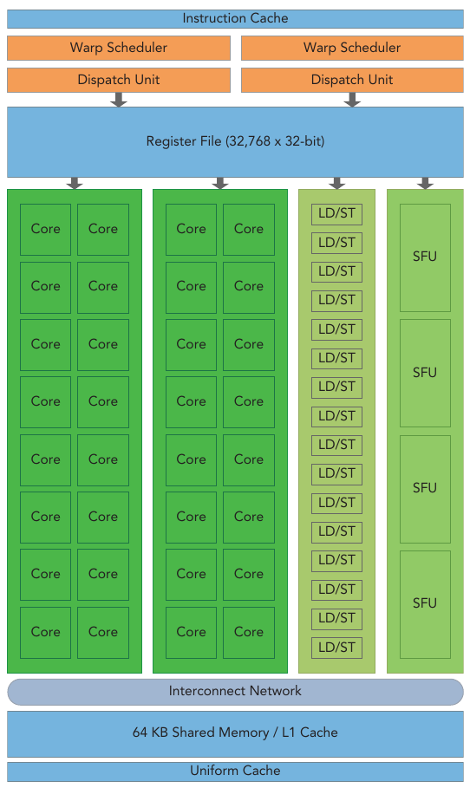
GPU architecture
GPUs are scalable arrays of Streaming Multiprocessors
SMs are the building blocks of a GPU:
  CUDA cores (FP32, FP64, INT, Tensor)
  Memories
  Load/store units
  Special function units
  Warp schedulers
Warps are groups of 32 threads
All threads in a warp execute the same instruction at the same time
Conceptually, threads are mapped to core, blocks to SMs and grids to the entire device

Slide 133
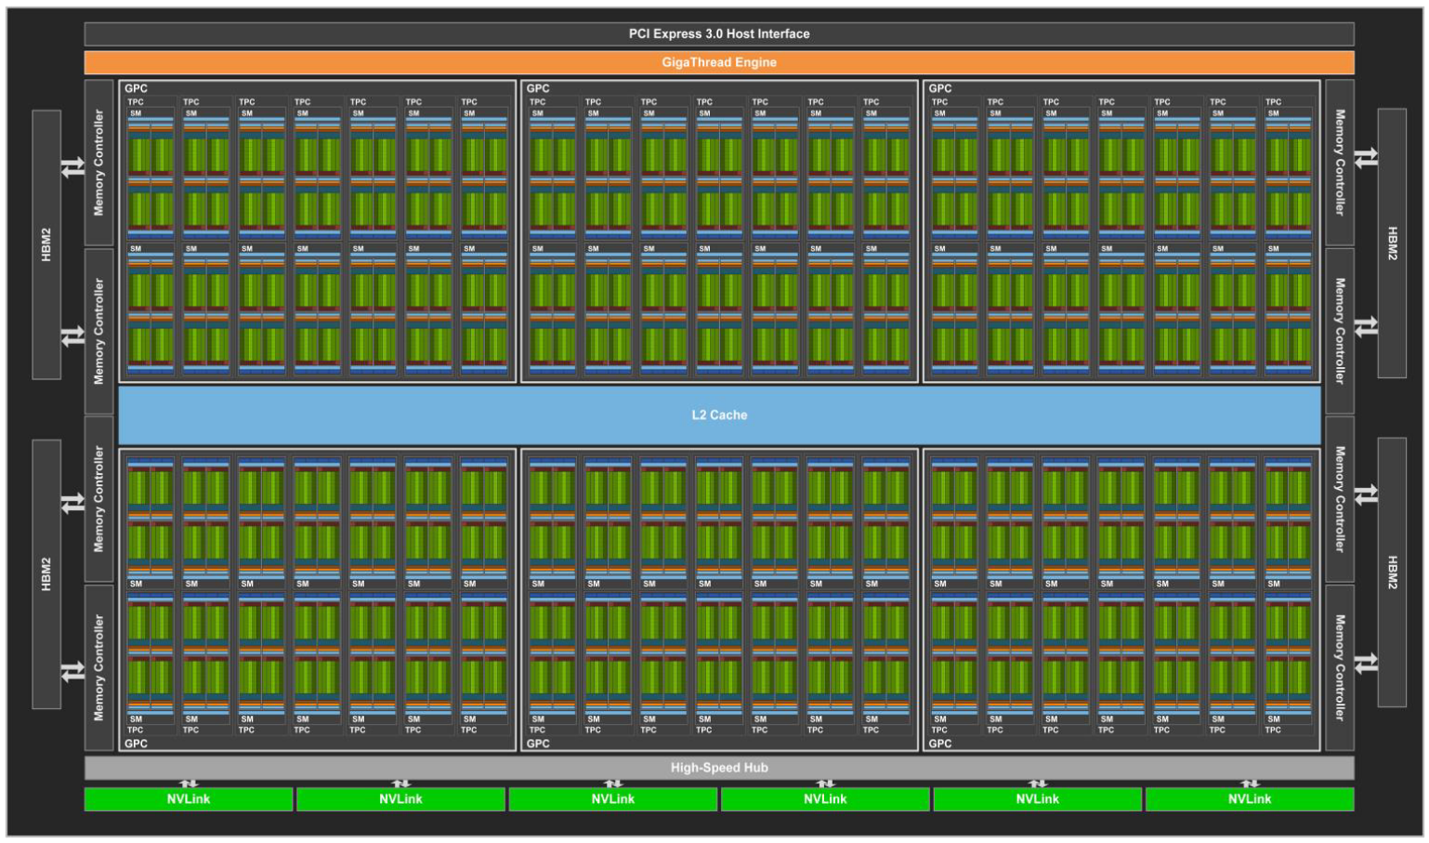
GPU architecture
NVIDIA V100
SM
80 SMs
5120 FP32 cores, 2560 FP64 cores

Slide 134
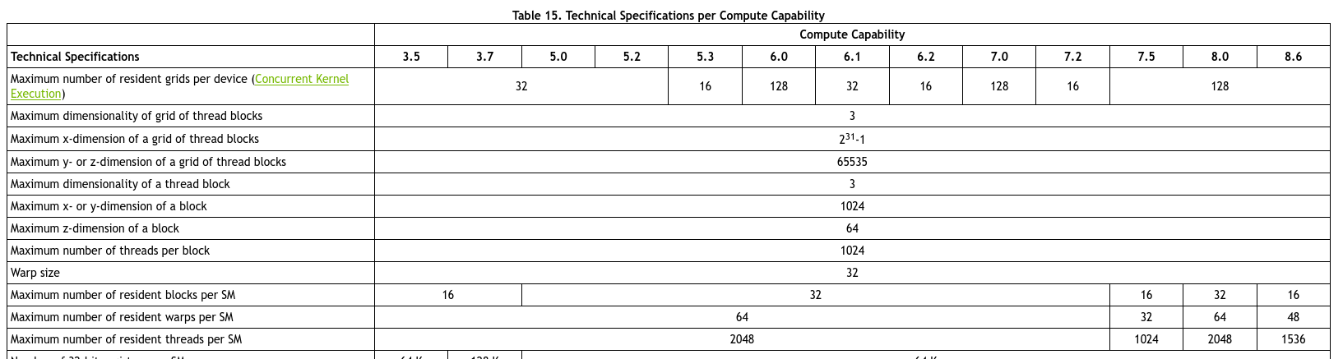
Compute capability
All NVIDIA GPUs are sorted according to their Compute Capability (CC)
It represents hardware capabilities
It comprises a major revision number X and a minor number Y and is denoted X.Y
Every GPUs with the same major revision number are of the same core architecture
V100
https://docs.nvidia.com/cuda/cuda-c-programming-guide/index.html#compute-capabilities

Slide 135
Query GPU information
Three ways to get information about GPUs
  On the NVIDIA website
  Using the NVIDIA System Management Interface (nvidia-smi) tool
  Programmatically
nvidia-smi (more for monitoring)
  $> nvidia-smi Summary of the GPUs and their properties
  $> nvidia-smi -h Help
  $> nvidia-smi -L List all GPUs
  GPU 0: Tesla V100-PCIE-32GB (UUID: GPU-755c7edb-fed2-d142-dd3a-ad6fec3ef7ce)
  GPU 1: Tesla V100-PCIE-32GB (UUID: GPU-351d1c1d-188a-be67-5afc-4aef744c3fa2)
  $> nvidia-smi -q -i 0 More info about GPU #0
  Driver Version : 455.23.05
  CUDA Version : 11.1
  Attached GPUs : 2
  GPU 00000000:86:00.0
  Product Name : Tesla V100-PCIE-32GB
  Product Brand : Tesla
  Display Mode : Enabled
  …

Slide 136
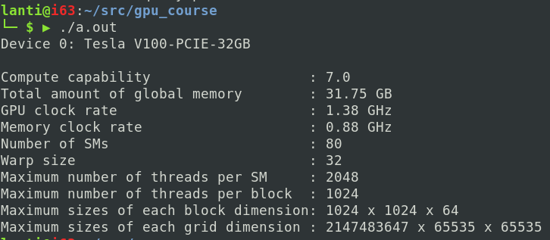
Query GPU information programmatically
Use cudaGetDeviceProperties function:
integer function cudaGetDeviceProperties( prop, devnum )
type(cudadeviceprop), intent(out) :: prop ! Structure containing many GPU properties
integer, intent(in) :: devnum ! Device number
program queryGpu
use cudafor
implicit none
real, parameter :: GBUnit = 1024 * 1024 * 1024.0
real, parameter :: GHzUnit = 1e6
integer :: istat, devId
type(cudadeviceprop) :: properties
devId = 0
istat = cudaGetDeviceProperties(properties, devId)
write(*,'(A,I0,2A)') "Device ", devId, ": ", properties%name
write(*,'(A,T38,A,I0,A,I0)') "Compute capability", ": ", properties%major, ".", properties%minor
write(*,'(A,T38,A,F5.2,A)') "Total amount of global memory", ": ", properties%totalGlobalMem / GBUnit, " GB"
write(*,'(A,T38,A,F4.2,A)') "GPU clock rate", ": ", properties%clockRate / GHzUnit, " GHz"
write(*,'(A,T38,A,F4.2,A)') "Memory clock rate", ": ", properties%memoryClockRate / GHzUnit, " GHz"
write(*,'(A,T38,A,I0)') "Number of SMs", ": ", properties%multiProcessorCount
write(*,'(A,T38,A,I0)') "Warp size", ": ", properties%warpSize
write(*,'(A,T38,A,I0)') "Maximum number of threads per SM", ": ", properties%maxThreadsPerMultiprocessor
write(*,'(A,T38,A,I0)') "Maximum number of threads per block", ": ", properties%maxThreadsPerBlock
write(*,'(A,T38,A,I0,A,I0,A,I0)') "Maximum sizes of each block dimension", ": ", properties%maxThreadsDim(1), &
" x ", properties%maxThreadsDim(2), " x ", properties%maxThreadsDim(3)
write(*,'(A,T38,A,I0,A,I0,A,I0)') "Maximum sizes of each grid dimension", ": ", properties%maxGridSize(1), &
" x ", properties%maxGridSize(2), " x ", properties%maxGridSize(3)
end program queryGpu

